Slide 1
Circuit Analyzing
Prepared by HandZ STEM
Notes:
Hello Everyone, Today, we gonna talk about Circuit Analyzing.

Slide 2
Content
What is the Circuit Analyzing?
What is the KCL?
How to Make Nodal Voltage Analysis
What is the KVL?
How to Make Mesh Current Analysis
Application
Notes:
The content of this video have discussing of What is the Circuit Analyzing, What is the Kirchoff Current Law then How to make Nodal Voltage Analysis, What is the Kirchoff Voltage Law then How to make Mesh Current Analysis, in the final we are going to implement a sample circuit analyzing.

Slide 3
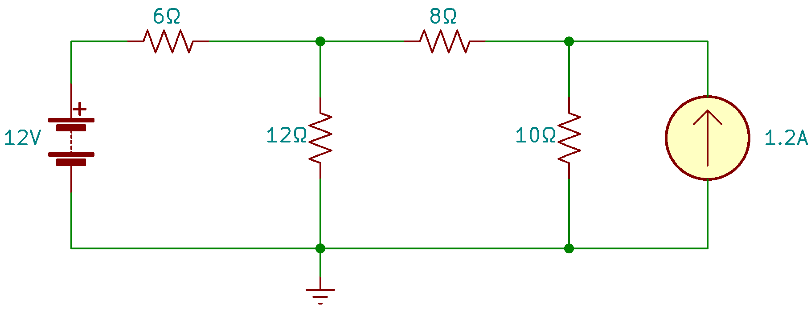
What is the Circuit Analyzing?

Slide 4
What is KCL?

Slide 5
How to Make Nodal Voltage Analysis

Slide 6
What is KVL?

Slide 7
How to Make Mesh Current Analysis

Slide 8
Application

Slide 9
Thank You For Your Listening
Prepared by HandZ STEM

